Slide 1

MED-AUXILIATOR Under the Guidance of Prof. P.D. Desai
By:
Piyush Singh - 2BV08CS059
Nirusha Shetty - 2BV09CS064
Rohit Raj - 2BV09CS082
Suraj R. Prabhu - 2BV09CS110
Gagan Purad - 2BV10CS402

Slide 2
Contents:

Slide 3
Abstract
Image processing is an expanding field with its applications spreading across several domains.
There is extensive use of digital images for medical purposes which involves critical decisions to be made based on the elucidation of medical images such as MRI scan, CT scan, X-ray etc., and calls for substantial research.
The proposed system performs content based retrieval of cases similar to the MRI scan loaded as query using Gabor wavelet based edge detection on hexagonal resampled grid.
Proposes an algorithm for identification of ailment, if present. The work is restricted to identification of three brain pathologies viz. tumor, bleed and infarction.
The project intends to assist doctors in identifying the abnormalities.

Slide 4
Introduction

Slide 5
Problem Definition
The Purpose of the project is to design a system which enhances the quality of medical scans and has some diagnostic capabilities in order to identify the defect. The proposed system should also retrieve visually similar images for reference.

Slide 6
Objectives
To extract the features such as colour, texture and shape using the gabor filter.
To transform a discrete image which is defined at one set of coordinate locations to a new set of coordinate points i.e., converting from rectangular to hexagonal grid.
To enhance the scans of medical images for better visibility.
To diagnose the ailment.
To provide visual indication of the affected area.
To provide a brief description of the problem detected.
To retrieve images of similar cases for reference.

Slide 7
Operating Environment
Hardware Requirements
Core 2 Duo processor or above
Processor speed: 1.6 GHz
Physical Memory (RAM): 2.0 GB
Disk Space: 6.00 GB
Software Requirements
Development OS: Windows XP/7
MATLAB 7.5 or above

Slide 8
Functional Requirements
The user shall be able to load a query image.
The system shall be able to extract the features such as colour, texture and shape using the Gabor filter.
The system shall be able to transform a discrete image which is defined at one set of coordinate locations to a new set of coordinate points i.e., converting from rectangular to hexagonal grid.
The system shall be able to enhance the scans of medical images for better visibility.
The system shall be able to diagnose the ailment.
The system shall be able to provide visual indication of the affected area.
The system shall be able to provide a brief description of the problem detected.
The user shall be able to retrieve images of similar cases for reference.

Slide 9
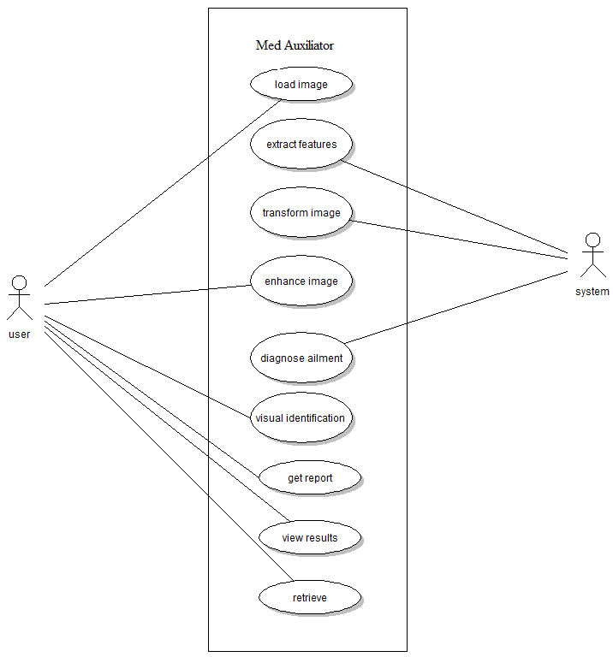
Use Case diagram

Slide 10
Non-functional requirements
Performance Requirements
Response time - For any given query image, the relevant information is retrieved within 5 seconds
Efficiency Systems performance should be above 80%.
Safety Requirements
The user should take periodic backups of the scans to prevent the loss of any data.
Security Requirements
Users will not be able to use the system without proper authentication.

Slide 11
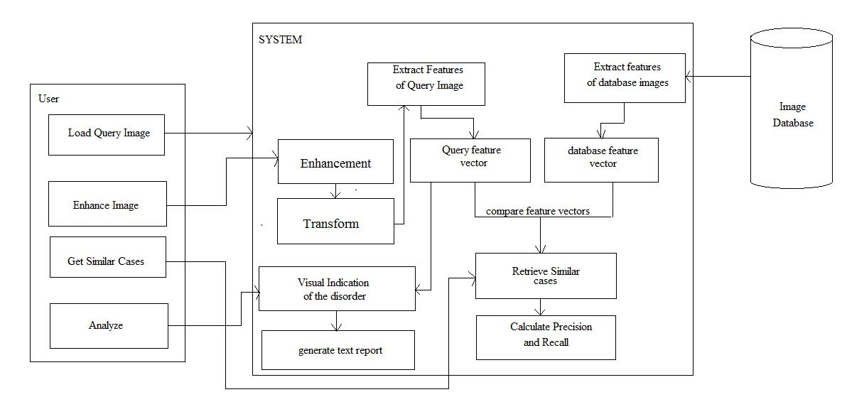
Architectural Design
Figure: Logical view

Slide 12
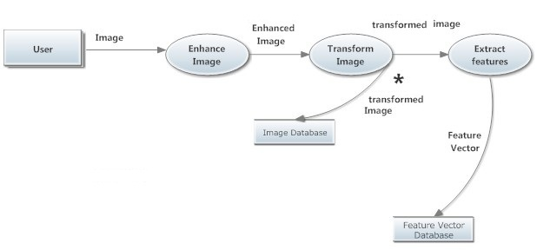
Data Flow diagram
Pre-Processing

Slide 13
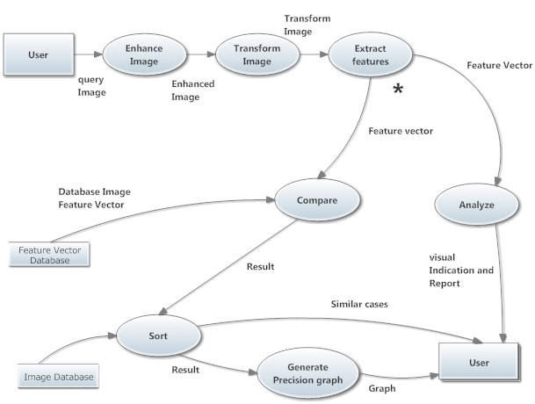
DFD of Complete System

Slide 14
Load query Image
Proposed Methodology
For
Retrieval
Database Images
Hexagonal Resampling
Hexagonal Resampling
Edge Detection Using Gabor Filters
Edge Detection Using Gabor Filters
Shape Feature Extraction using Moment Invariants
Shape Feature Extraction using Moment Invariants
Texture Feature Extraction using GLCM
Shape Feature Extraction using GLCM
Euclidean Distance Calculation
Query Feature
Vector
Database Feature Vector
Retrieval of Similar Cases

Slide 15
Proposed Methodology For Analysis
Query Image
Segmentation
Left Half
Right Half
Compare with Energy values of Infarct
Calculate Intensity
Calculate Intensity
Regions with maximum match is identified
Difference
Classify into two categories
Category 1
(Infarct)
Normal Brain Image(If < 80% match with either defect case)
Category 2
(Bleed/Tumor/Normal)
Matched with bleed and tumor energy patterns
Region with > 80% match is identified.

Slide 16
Sl. no | Test Case | Input | Expected Output | Actual Output | Test State | Test Priority
1. | Load query image | Query image | Query image is displayed | Query image is displayed | Pass | 4
2. | Invalid image format | Image(invalid format) | image not loaded and error message is displayed | image not loaded and error message is displayed | Pass | 4
3. | Clicking ‘Load Query Image’ button | Click on the ‘Load Query Image’ button | User shall be able to browse the image | User shall be able to browse the image | Pass | 5
4. | Clicking ‘Enhance Image’ button | Click on the ‘Enhance Image’ button | Enhancement window opens | Enhancement window opens | Pass | 5
5. | Enhancing image | Query image | Query image is enhanced | Query image is enhanced | Pass | 4
6. | Resampling image to hexagonal grid | Query image in rectangular lattice | Resampled image on hexagonal grid | Resampled image on hexagonal grid | Pass | 4
7. | Feature Extraction | Valid query image | Features are stored in a vector | Features are stored in a vector | Pass | 1
8. | Retrieve similar images | Processed MRI scan of the brain | Retrieval of similar cases | Retrieval of similar cases | Pass | 3
9. | Diagnose ailment | MRI scan of the brain with defect | Abnormality is detected, if any | Abnormality is detected, if any | Pass | 2
10. | Visual indication of affected area | Image with ailment. | Affected area is highlighted | Affected area is highlighted | Pass | 2
11. | Generate text report | Analyzed image | Textual description of the diagnosis | Textual description of the diagnosis | Pass | 4

Slide 17
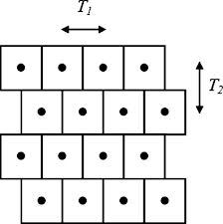
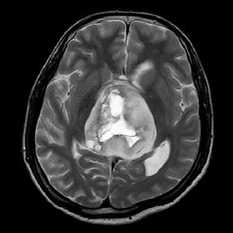
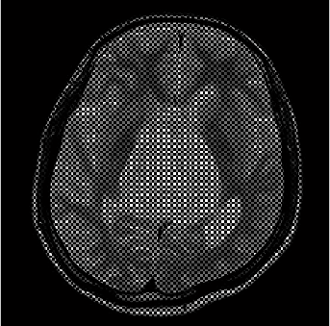
Hexagonal Sampled grid
Half Pixel Shift Method
Query image
Resampled Image

Slide 18
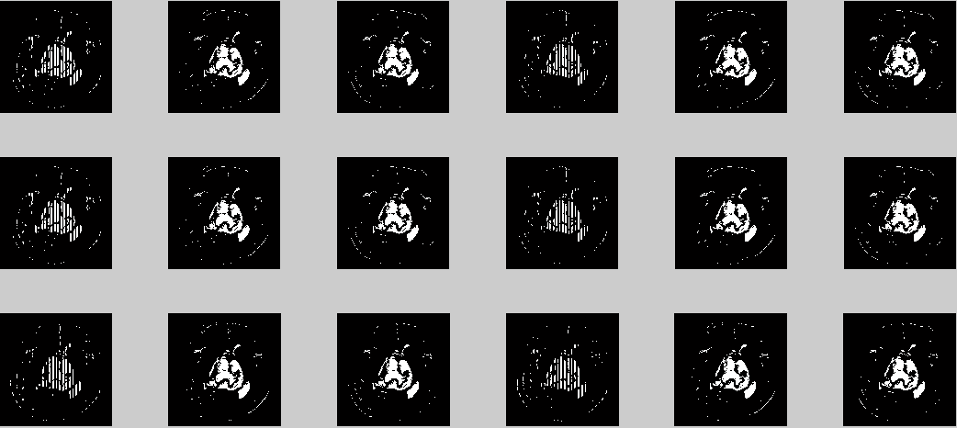
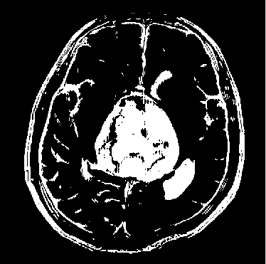
Shape Feature Extraction
Shape can be described by simple geometric features such as moment of inertia, skew invariants, center of gravity etc.
The extraction of shape features starts with detection of edges. For this purpose Gabor filter is applied on six scale values and three orientations – 0⁰, 60⁰, 120⁰, resulting in 6x3 = 18 edge-maps. Out of these only those satisfying the threshold value are superimposed to get the final edge-map.
Final Edge-map
Gabor Responses

Slide 19
Texture Feature Extraction
Important data regarding the structural arrangement of the surface is contained inside the texture features.
Relationship between the surface and external environment can also be provided by them. For extraction of texture features, Grey Level Co-occurrence Matrix is used.
The texture values are appended to the previously stored shape feature values in the same vector.
Feature vector table
The texture values are appended to the previously stored shape feature values in the same vector.

Slide 20
Distance Calculation
The database feature vector for all the images in the database is created in accordance with the above mentioned process of feature extraction so is the feature vector for the query image. The Euclidean distance between the query and each of the database feature vectors.

Slide 21
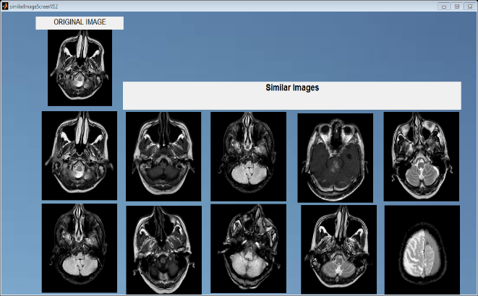
Retrieval Result
Retrieval result for sample 1

Slide 22
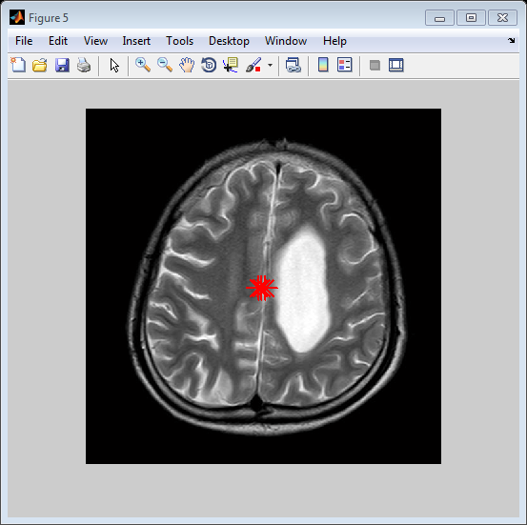
Analysis Result
Figure: Tumor Identified

Slide 23
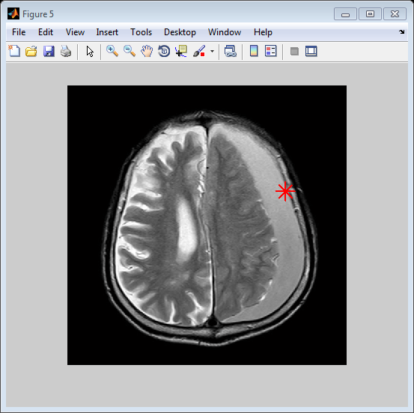
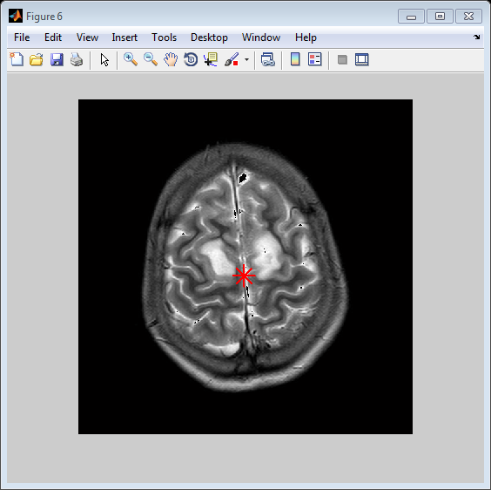
Figure: Bleed Identified
Figure: Infarct Identified

Slide 24
Retrieval efficiency
Image Id | Precision | Recall
14 | 80.0 | 47.4
24 | 70.0 | 13.5
37 | 90.0 | 24.8
92 | 80.0 | 51.3

Slide 25
Analysis Efficiency
Scan ID | Ailment present | Ailment Found | Affected region correctly identified
H | Tumor | Tumor | Yes
C | Bleed | Bleed | Yes
B | Bleed | Bleed | No
G | None(normal) | None(normal) | Yes
AC | Infarct | Infarct | Yes
ABC1 | Infarct | Infarct | No
D | Infarct | Infarct | Yes

Slide 26
Conclusion
This study proposed a model for Content Based Image Retrieval by using shape and texture features of the images.
The measure of similarity between the query image and the database images is done by calculating the Euclidean distance.
The second component of the system consists of detection of ailment in the MRI scans of human brain for three pathologies – tumor, bleed and infarct.
Visual indication is provided for the affected region in the brain for assistance to the doctors or other medical professionals in the process of analysis.
The system has been developed successfully in an efficient manner to achieve the expected output.

